Slide 1
Tech Session - Ember Components
Dilasha Shah

Slide 2
CONTENT
Routing and templates refresher
Introduction
Ember Components
Features
Anatomy
Customization
Content Wrapping
Contextual Components
Interaction with surroundings
Receiving information
Triggering changes
Lifecycle hooks
Some friends of ember components

Slide 3
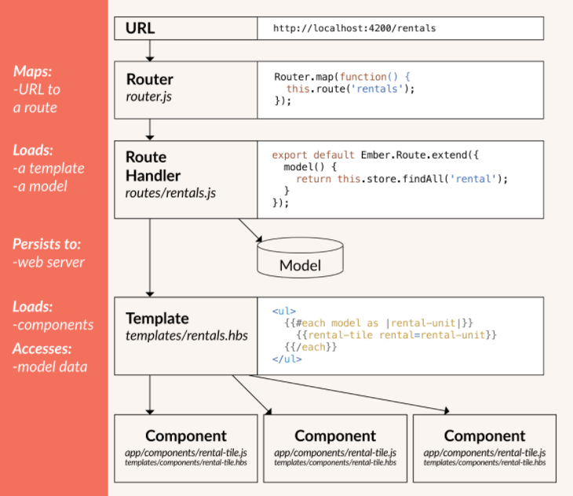
ROUTING AND TEMPLATES (refresher)

Slide 4
Introduction

Slide 5
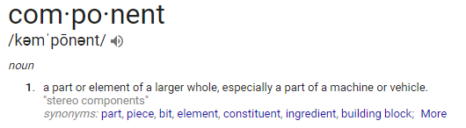
WHAT IS A COMPONENT?
In Ember, components are isolated, reusable chunks of code that extend the HTML standard to create complex, interactive User Interfaces

Slide 6
Ember Components

Slide 7
FEATURES
Isolated from surroundings
Enables reuse of chunks of code
Helps minimize duplication
Allows nesting
Extends HTML but still adheres closely to W3C standards
“While templates describe how a user interface looks, components control how the user interface behaves.”
- guides.emberjs.com

Slide 8
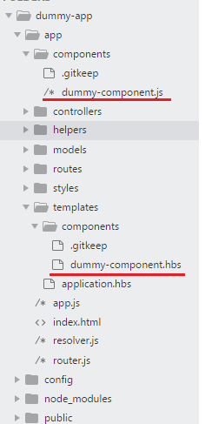
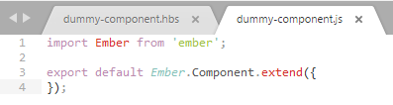

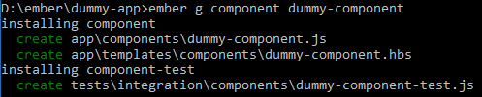
ANATOMY
Handlebars template
JavaScript file

Slide 9
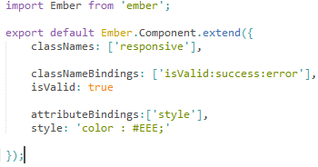


CUSTOMIZATION
<div> tag assigned as component root by default
Root element can be customized during invocation or in its JS file

Slide 10


CONTENT WRAPPING
Ember components can be used in 2 ways
Inline
Without content inside
Block
Allows components to be passed into another component as handlebars template
The passed block can be rendered through the {{yield}} expression

Slide 11
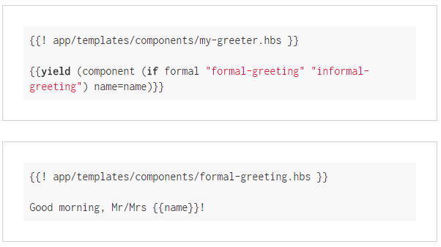


CONTEXTUAL COMPONENTS
Introduced in Ember 2.3 to improve component composition
Useful in creating complex nested component structures
item-list component
item-row component

Slide 12
Interaction with surroundings
Data down, Action up

Slide 13
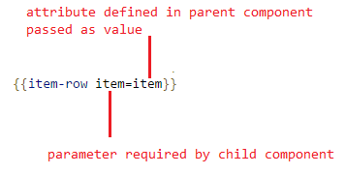
RECEIVING INFORMATION – WITH PARAMETERS
Components are isolated from surroundings so data required needs to be passed in through parameters
Passed in parameters are ‘bound’ to sync by default but can this behaviour can be modified in child component
Data is passed into child components by their parent

Slide 14
TRIGGERING CHANGES – WITH EVENTS
Ember provides a number of pre-defined events that can be used to trigger changes and increase interactivity
click
doubleClick
dragOver
drop
mouseDown
mouseUp
submit …and more

Slide 15
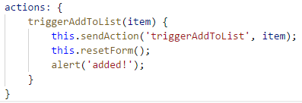
TRIGGERING CHANGES – WITH ACTIONS
Must be used to communicate with the component’s parent
Can be used to handle custom events
All actions must be defined in the component’s actions hook which can then be called using the {{action}} helper

Slide 16
LIFECYCLE HOOKS

Slide 17
LIFECYCLE HOOKS - On initial render
init()
Used to initialize component and objects to their initial states
didReceiveAttr()
Fired each time an attribute is updated
willRender()
Called before rendering starts
didInsertElement()
Fired after component is created and inserted into DOM
Perfect for initializing 3rd party libraries like jQuery
didRender()
Fired after component is rendered and DOM is updated
For post-processing on component DOM after it has been updated

Slide 18
LIFECYCLE HOOKS - On re-render
didUpdateAttrs()
Fires when attributes of a component have changed, runs prior to re-render
didRecieveAttrs()
willUpdate()
Called when the component is about to update itself
willRender()
didUpdate()
Called after the component has updated itself
didRender()

Slide 19
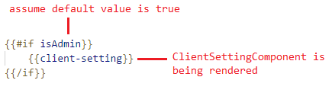
LIFECYCLE HOOKS – On component destroy
willDestroyElement()
Triggered when component detects it is time to remove itself from the DOM
Used for any teardown logic when exiting the component
willClearRender()
Fired right before component DOM elements are cleared and re-render occurs
didDestroyElement()
Fired after a component is destroyed and DOM has been cleared
A component can be ‘destroyed’ when route transition takes place or conditional values in a template is changed
component destroyed if value of isAdmin is changed to false

Slide 20
Some friends of ember components

Slide 21
MIXINS
Great for dividing pieces of reusable code into smaller singular responsibility objects
Can be used/shared across multiple components (or routes)

Slide 22

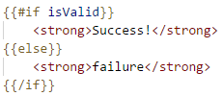
HELPERS
Conditional helpers
Iteration helpers
Attribute helpers
Link helpers
Action helpers
Input helpers

Slide 23
QUESTIONS?

Slide 24
Demo
shopping-list app

Slide 25
THANK YOU

